Slide 1
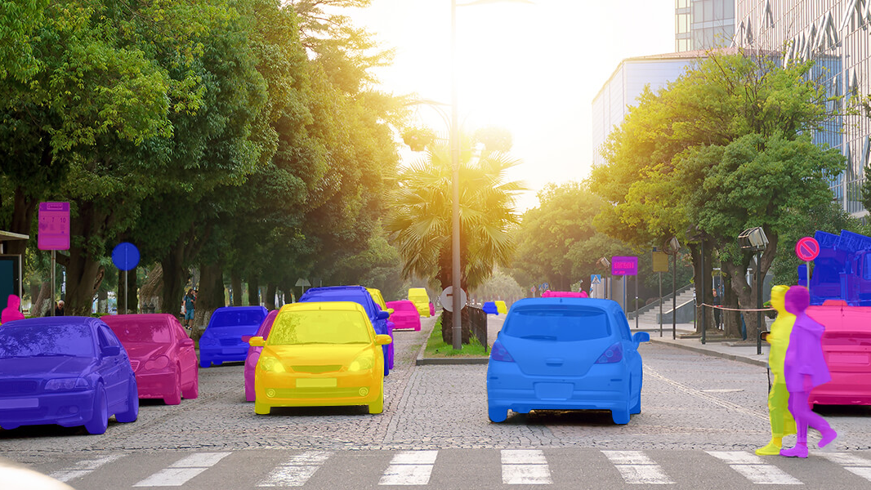
DS 677002 Deep Learning Project Semantic Segmentation on Autonomous Driving using FCN
04-30-2024
Balaji Kolusu (bk423) - Data Science Dept.
Karthik Mohan (km874) - Data Science Dept.
Sriram Gottipati (sg2495) - Data Science Dept.
Tribhuvan Chanda (tc482) - Data Science Dept.

Slide 2
background and Motivation
Image segmentation involves dividing an image into segments to simplify or change its representation, making it more meaningful and easier to analyze.
Essential for understanding road scenes in real-time. It helps in detecting objects like vehicles, pedestrians, traffic signs, and road boundaries.
Autonomous vehicles must navigate through varying weather conditions, diverse urban and rural landscapes, and unpredictable human behavior, making robust image segmentation crucial.
Autonomous systems rely on diverse datasets to train models that can accurately understand and segment images from multiple perspectives and weather scenarios.
Enhancing the accuracy of image segmentation directly contributes to the safety and reliability of autonomous vehicles by improving their decision-making capabilities in complex environments.

Slide 3
RElated works
"Fully Convolutional Networks for Semantic Segmentation," CVPR, 2015.
Discuss the evolution from early convolutional neural networks to more advanced architectures like FCN (Fully Convolutional Network) and SegNet.
"U-Net: Convolutional Networks for Biomedical Image Segmentation," MICCAI, 2015
Highlight significant advancements in U-Net architecture and its adaptations for various segmentation tasks.
"Doubly Contrastive End-to-End Semantic Segmentation for Autonomous Driving under Adverse Weather"
Jongoh Jeong, Jong-Hwan Kim
Uses a double contrastive learning strategy to better differentiate between similar features under challenging conditions.

Slide 4
How does u-net work ?
Input Layer: The network starts with an input layer that takes in images captured from vehicle cameras. The images are pre-processed images to normalize lighting conditions, enhance contrast.
Contracting Path (Encoder): consists of repeated application of two 3x3 convolutions, each followed by a rectified linear unit (ReLU) and a 2x2 max pooling operation with stride 2 for downsampling. Helps in capturing the hierarchical features of the image. At each downsampling step, the number of feature channels is doubled. This increase in depth helps the network learn more complex features at various scales.
Bottleneck: Transition zone between the contracting and expanding paths. Consists of two convolutional layers with ReLU activations, which prepare the feature maps for the subsequent upsampling in the expanding path.

Slide 5
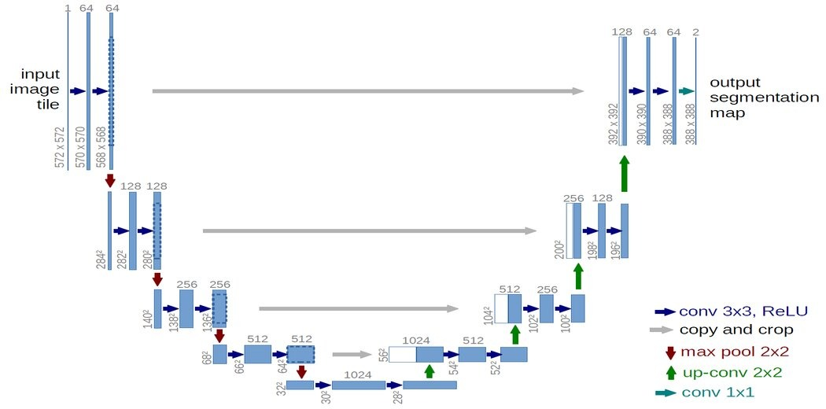
U-Net archietecture

Slide 6
How does u-net work ?
Expanding Path (Decoder): involves upsampling the feature map followed by a 2x2 convolution (“up-convolution”) that halves the number of feature channels, a concatenation with the correspondingly cropped feature map from the contracting path, and two 3x3 convolutions, each followed by a ReLU. This stage helps the network localize and refine the segmentation details. Skip connections provide a pathway that brings information directly from the contracting path to the expanding path, aiding in precise localization by combining general and local information in the network.
Output Layer: Consists of a 1x1 convolution that maps each 64-component feature vector to the desired number of classes. In the context of autonomous driving, this typically includes classes like road, pedestrian, vehicles,

Slide 7
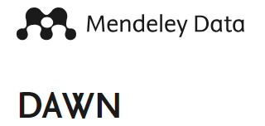
Dataset Composition: Utilized the Mendeley Dawn dataset, which comprises a diverse collection of street images captured under various weather conditions.
Weather Conditions Covered:
Fog: Images feature reduced visibility scenarios, crucial for testing the model’s performance in obscured conditions.
Rain: Includes wet surfaces and rain streaks to segment distinct objects accurately.
Snow: Captures snowy environments where the contrast between objects and background can be minimal.
Sand: Scenarios with airborne sand, which can degrade image clarity and alter the appearance of road and objects.

Slide 8
Pre Processing
Before feeding images into the U-Net, they must be prepared to ensure consistency and optimal performance.
Normalization: Scaling pixel values to a standard range, typically 0-1, to facilitate faster and more stable convergence during training.
Resizing: Adjusting the image size to match the input dimensions required by the U-Net model, ensuring all images are uniform in size, which is crucial for batch processing.

Slide 9
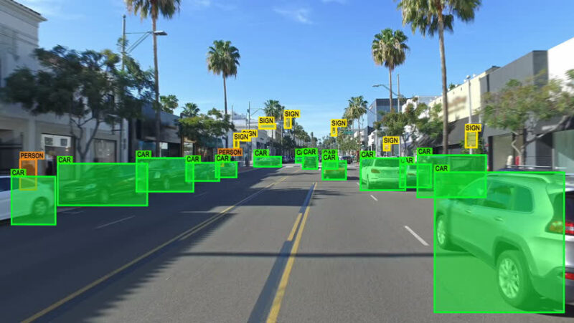
Model Training
Augmentation: enhance the model's ability to generalize from the training data to real-world scenarios by artificially expanding the dataset with modified versions of the training images which Includes geometric transformations like rotation (to simulate camera angle changes), translation (shifting entire image or parts of an image in one or more directions), scaling (to simulate objects at various distances), and flipping (to simulate driving in different directions).
Annotation: Each object in the image (e.g., pedestrians, vehicles, lanes) is labeled with a distinct class. We used an external tool called labelbox to automate image annotation
by integrating it in collab through API.

Slide 10
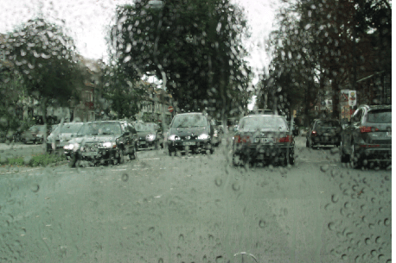
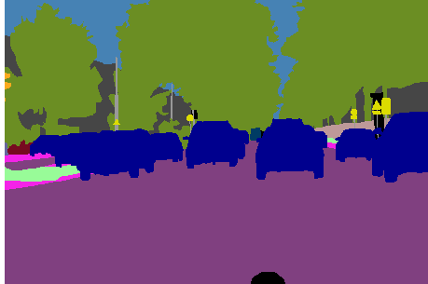
Experimental results and analysis
Mean Intersection over Union (mIoU) scores are a more specific measure of accuracy in the context of semantic segmentation. We achieved a mIoU score of 73%. This score reflects a high level of accuracy in our model's ability to segment images, indicating effective learning and prediction capabilities.

Slide 11
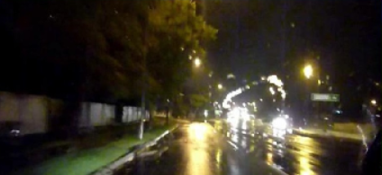
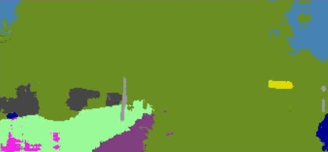
Experimental results and analysis
Drop in performance during adverse weather conditions at night.

Slide 12
Future works
Incorporate multiscale feature extraction techniques to handle the variations in visibility and object sizes caused by different weather conditions, ensuring robust detection at various scales.
Utilize simulation technologies to artificially create diverse weather conditions in training data, enhancing the model's exposure to various scenarios without the need for extensive field data collection.

Slide 13
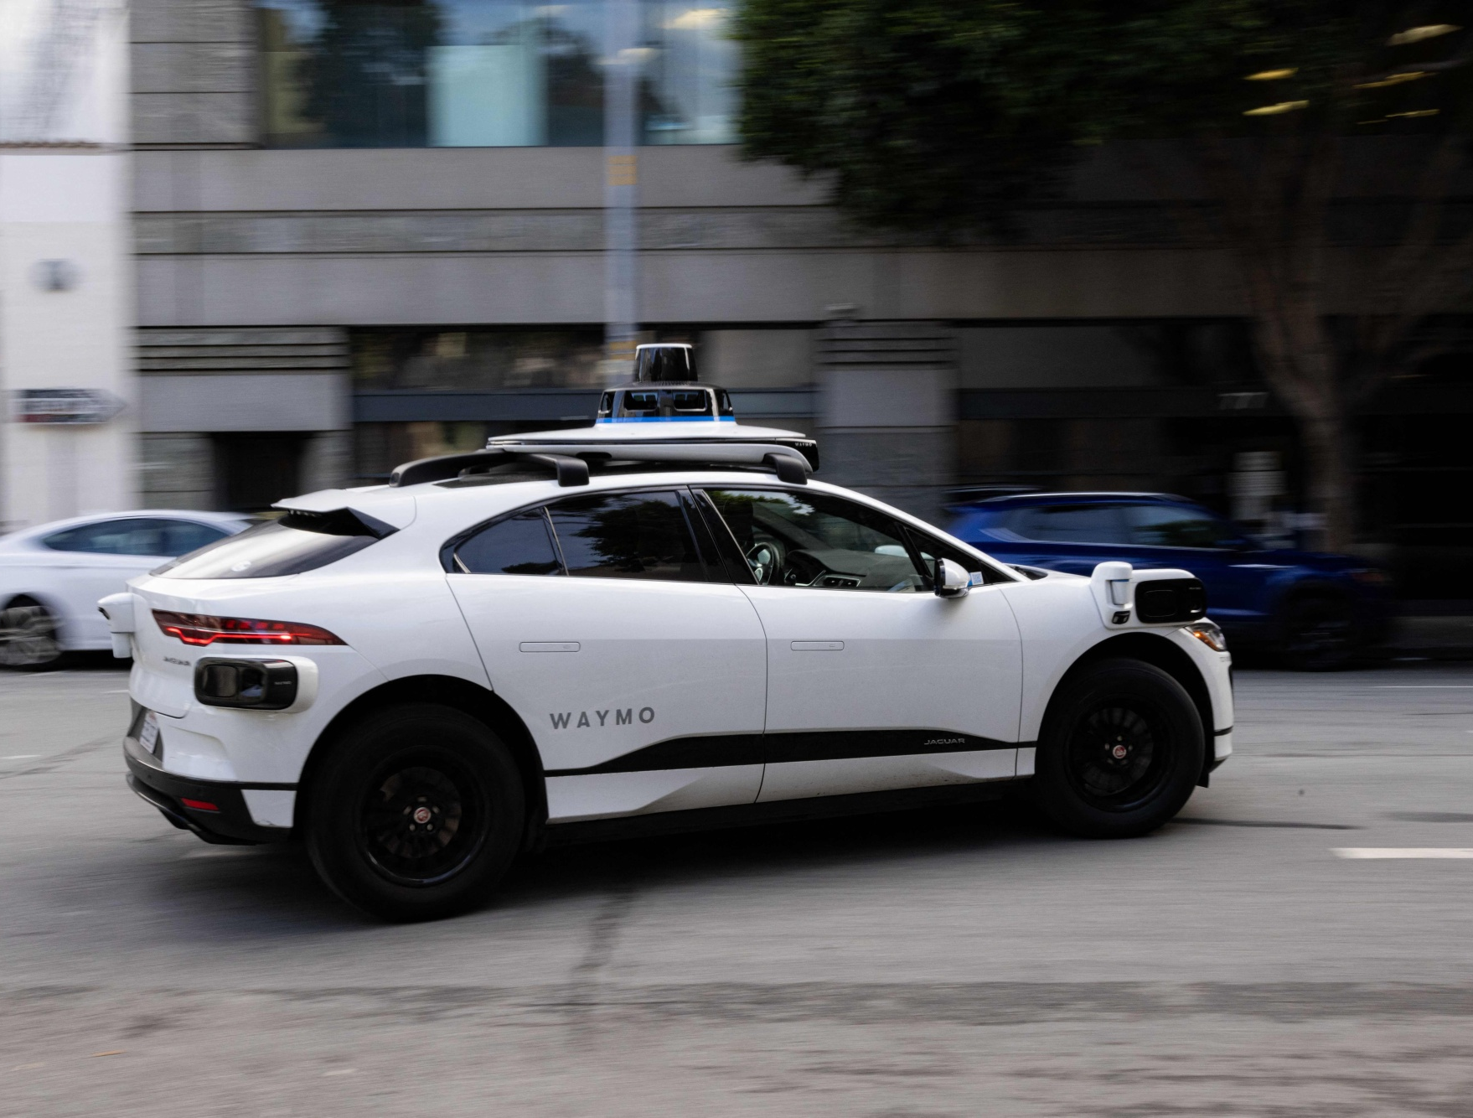
Thank you
A Waymo self-driving car fitted with rooftop sensors cruising through an urban street

